Slide 1
Statistics
Introduction to Hypothesis Testing

Slide 2
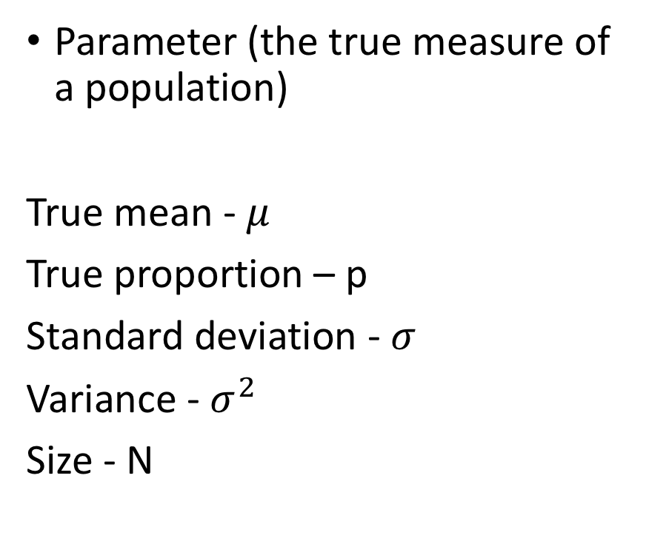
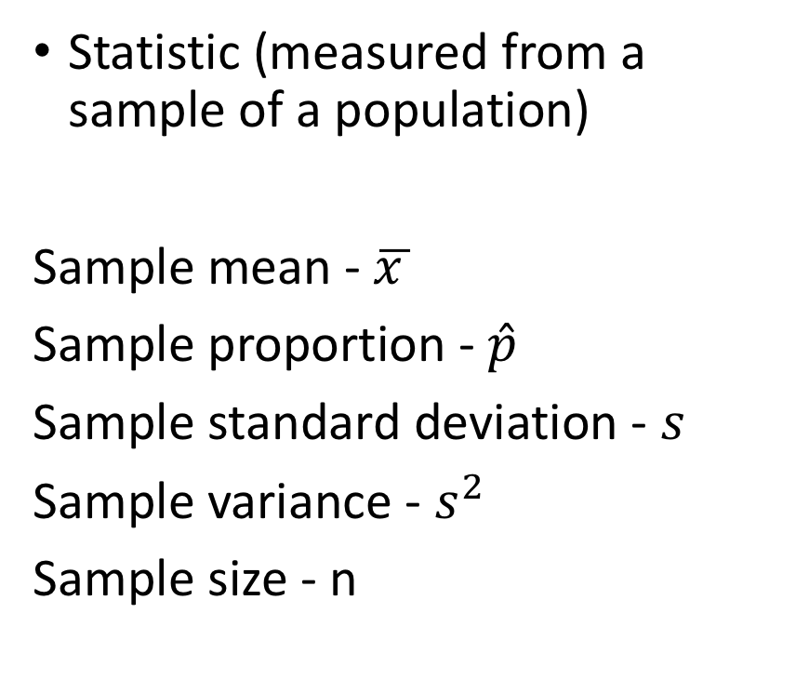
Statistic Versus Parameter (Review)
Statistic (measured from a sample of a population)
Sample mean - $\overline{x }$
Sample proportion - $\hat{p}$
Sample standard deviation - $s$
Sample variance - $s^{2}$
Sample size - n
Parameter (the true measure of a population)
True mean - $μ$
True proportion – p
Standard deviation - $σ$
Variance - $σ^{2}$
Size - N

Slide 3
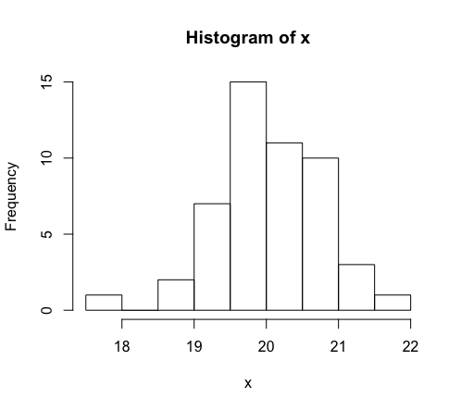
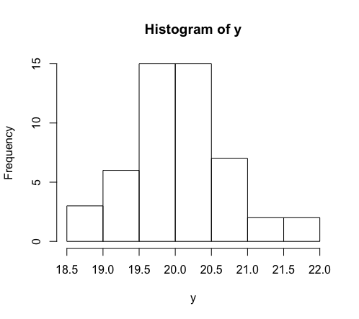
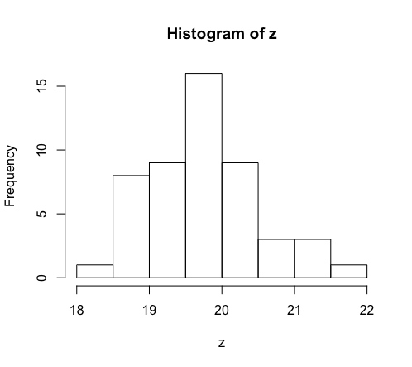
Deviations From Expected Outcomes
Do these samples come from the same population?
Answer: Yes, they are all randomly selected independent samples of size 50 from a normal population with mean 20 and standard deviation 0.75

Slide 4
Deviations From Expected Outcomes
Sample x:
Min. 1st Qu. Median Mean 3rd Qu. Max.
17.54 19.54 20.03 20.02 20.52 21.65
s = 0.763294
Sample y:
Min. 1st Qu. Median Mean 3rd Qu. Max.
18.54 19.63 20.08 20.06 20.36 21.80
s = 0.6740456
Sample z:
Min. 1st Qu. Median Mean 3rd Qu. Max.
18.18 19.36 19.74 19.78 20.25 21.88
s = 0.7938023

Slide 5
Deviations From Expected Outcomes
Sample x:
Min. 1st Qu. Median Mean 3rd Qu. Max.
17.54 19.54 20.03 20.02 20.52 21.65
s = 0.763294
Sample y:
Min. 1st Qu. Median Mean 3rd Qu. Max.
18.54 19.63 20.08 20.06 20.36 21.80
s = 0.6740456
Sample z:
Min. 1st Qu. Median Mean 3rd Qu. Max.
18.18 19.36 19.74 19.78 20.25 21.88
s = 0.7938023

Slide 6
Deviations From Expected Outcomes
Sample x:
Min. 1st Qu. Median Mean 3rd Qu. Max.
17.54 19.54 20.03 20.02 20.52 21.65
s = 0.763294
Sample y:
Min. 1st Qu. Median Mean 3rd Qu. Max.
18.54 19.63 20.08 20.06 20.36 21.80
s = 0.6740456
Sample z:
Min. 1st Qu. Median Mean 3rd Qu. Max.
18.18 19.36 19.74 19.78 20.25 21.88
s = 0.7938023

Slide 7
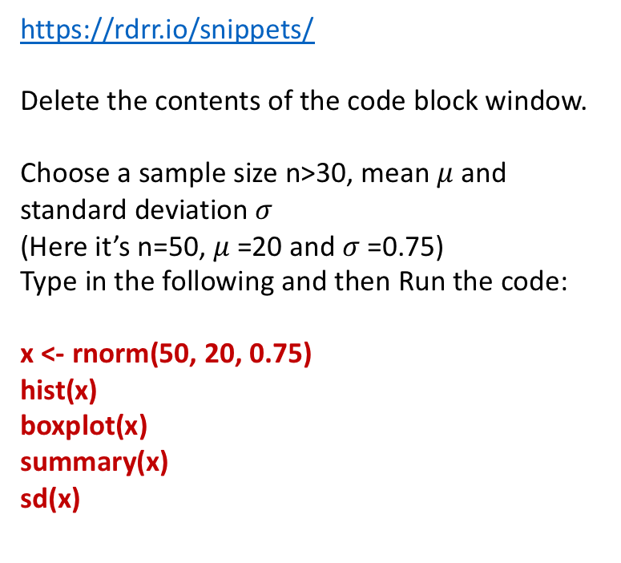
Try It Yourself – Population Mean
https://rdrr.io/snippets/
Delete the contents of the code block window.
Choose a sample size n>30, mean $μ$ and standard deviation $σ$
(Here it’s n=50, $μ$=20 and $σ$=0.75)
Type in the following and then Run the code:
x <- rnorm(50, 20, 0.75)
hist(x)
boxplot(x)
summary(x)
sd(x)
Sample x:
Min. 1st Qu. Median Mean 3rd Qu. Max.
17.54 19.54 20.03 20.02 20.52 21.65
s = 0.763294
Sample y:
Min. 1st Qu. Median Mean 3rd Qu. Max.
18.54 19.63 20.08 20.06 20.36 21.80
s = 0.6740456
Sample z:
Min. 1st Qu. Median Mean 3rd Qu. Max.
18.18 19.36 19.74 19.78 20.25 21.88
s = 0.7938023

Slide 8
Try It Yourself – Population Proportion (p)
https://rdrr.io/snippets/
Delete the contents of the code block window.
Choose number of observations n = 1000, sample size (trials) = 150, p = 0.25
Type in the following and then Run the code:
x <- rbinom(1000, 150, 0.25)
hist(x, freq=FALSE)
boxplot(x)
summary(x)
sd(x)
This simulation exercise would be appropriate for the following: A city mayor claims that the city employs 25% of its workforce as those who identify as black.
Assume a random sample of 150 workers is chosen, and the number (x) of black workers out of 150 is counted; this process repeated 1000 times.
If x = 37, then p = 37/150 = 0.247 (close to 0.25)
The code at the left shows how frequently we expect outcomes.
For example, if we take a sample of 150 and x = 27, does this seem “unusual” given the claim? Discuss.

Slide 9
Differences Between Statistics and Parameters Explained By:
True difference : The sample represents a new or different population than the parameter being tested.
Random variation: The observed difference is simply a condition of sampling (ie due to chance)
Sampling Error (bias): The sample is not representative of the population

Slide 10
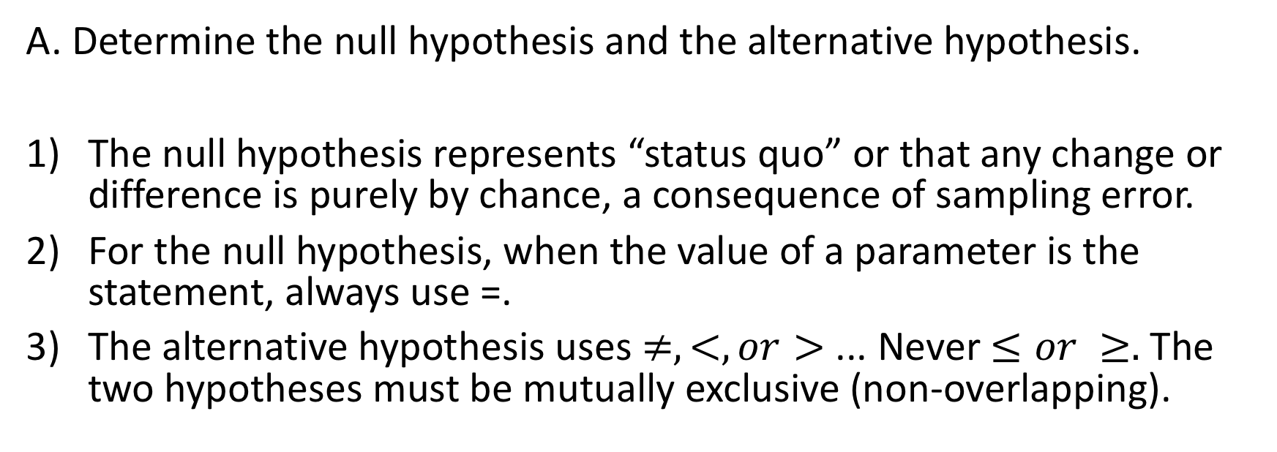
Hypothesis Testing is the scientific method to explain these differences
A. Determine the null hypothesis and the alternative hypothesis.
The null hypothesis represents “status quo” or that any change or difference is purely by chance, a consequence of sampling error.
For the null hypothesis, when the value of a parameter is the statement, always use =.
The alternative hypothesis uses $≠,<, or>$ ... Never $≤or ≥.$ The two hypotheses must be mutually exclusive (non-overlapping).

Slide 11
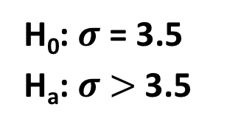
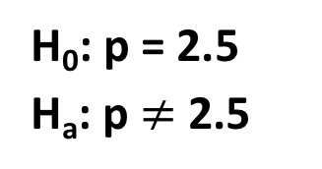
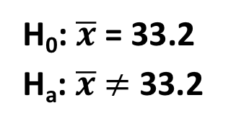
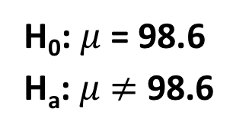
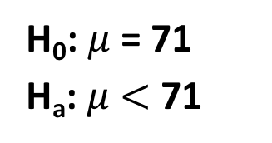
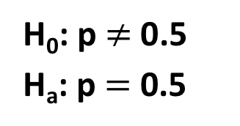
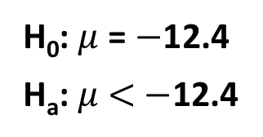
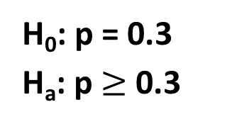
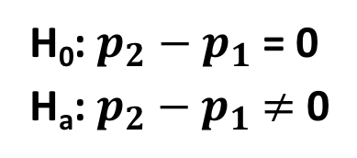
Which Are Valid Hypotheses? Why or why not?
H₀: $μ$ = 98.6
H_{a}: $μ$ $≠$ 98.6
H₀: p $≠$ 0.5
H_{a}: p $=$ 0.5
H₀: $σ$ = 3.5
H_{a}: $σ$ $>$ 3.5
H₀: p = 2.5
H_{a}: p $≠$ 2.5
H₀: $μ$ = 71
H_{a}: $μ$ $<$ 71
H₀: $p_{2}−p_{1}$ = 0
H_{a}: $p_{2}−p_{1}$ $≠$ 0
H₀: p = 0.3
H_{a}: p $≥$ 0.3
H₀: $\overline{x}$ = 33.2
H_{a}: $\overline{x}$ $≠$ 33.2
H₀: $μ$ = $−$12.4
H_{a}: $μ$ $<$ $−$12.4

Slide 12

Hypothesis Testing is the scientific method to explain these differences
B. Choose $α$ or significance level.
Action/True Situation | H₀ is true | H₀ is false
Reject H₀ | Type I error | Correct result
Fail to Reject H₀ | Correct result | Type II error
Pr(Type I error) = $α$ Pr(Type II error) = $β$
For any fixed α, an increase in the sample size n will cause a decrease in β.
For any fixed sample size n, a decrease in α will cause an increase in β. Conversely, an increase in α will cause a decrease in β.
To decrease both α and β, increase the sample size.

Slide 13
Hypothesis Testing is the scientific method to explain these differences
C. Assumption is that the null hypothesis is true.
Remember the “Rare Event Rule”: If, under a given assumption, the probability of a particular observed event is exceptionally small, it cannot have occurred by chance.
(In other words, there is cause to reject the assumption.)

Slide 14
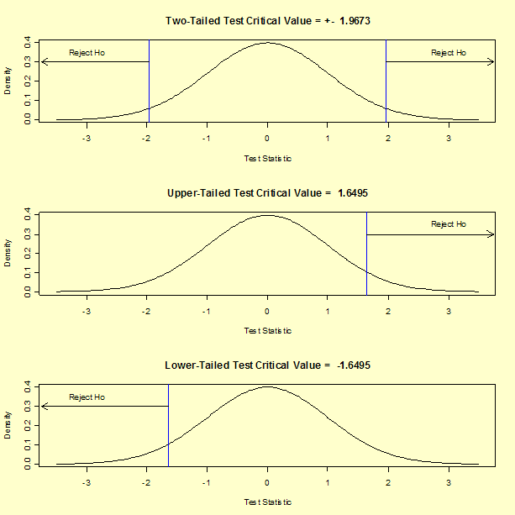




Hypothesis Testing Decision
H_{a}:$≠$
Z test shown here with $α$= 0.05 (most common)
C. So we “test” the assumption by calculating the probability of our observed event.
For discussion: What is the meaning of these pictures?
H_{a}:$>$
H_{a}:$<$

